Slide 1
UX Research & Statistics
Comprehensive Study Notes & Fundamentals

Slide 2
Usability Fundamentals
Definitions, Process, and Core Concepts

Slide 3






Core Definitions
UI vs. UX
Usability
Utility + Usability
UI is how the product looks. UX is how it feels. They work together to create the overall experience.
The extent to which a product ensures effectiveness, efficiency, and satisfaction for the user. It is a measure of quality.
Utility provides the features users need. Combined with Usability, it makes a product truly Useful.

Slide 4

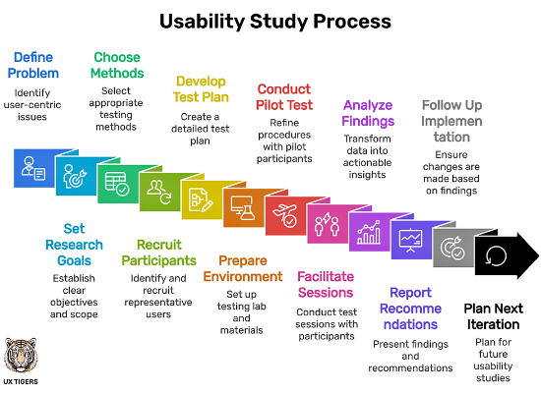
The Usability Testing Process
Plan: Define goals, recruiting criteria, and scripts.
Recruit: Find representative users.
Prepare: Set up the environment and materials.
Test: Facilitate the session (Moderated or Unmoderated).
Analyze: Review data for insights and metrics.
Report: Share findings to drive design improvements.

Slide 5
Key Usability Metrics
Metric | Focus | Description
Effectiveness | Completion | Can the user complete the task? (Success/Fail)
Efficiency | Resource | How much effort/time does it take? (Time on Task)
Satisfaction | Subjective | How comfortable is the user? (Likert Scale)
Learnability | Growth | Time to proficiency over multiple trials.

Slide 6
Research Methods
Types of Research & Experimental Design

Slide 7



Types of Research
Descriptive
Relational
Experimental
Observing and concluding that "X is happening". Good for initial understanding.
Finding connections between variables. "X is related to Y". Carries more weight than descriptive.
Establishing cause and effect. "X is responsible for Y". Involves manipulating Independent Variables.

Slide 8
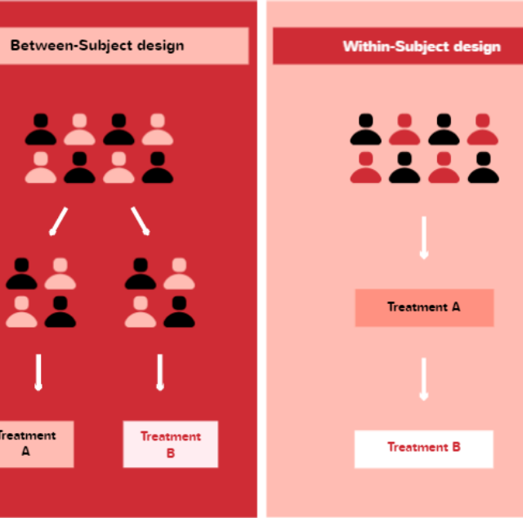
Experimental Design
Between-Subjects
Each participant is exposed to only one condition. Simpler logistics but requires more users to handle variability.
Within-Subjects
Each participant is exposed to multiple conditions. Each user serves as their own control, reducing variability. Ideally requires fewer users.

Slide 9
Statistics & Analysis
Variables, Distributions, and Hypotheses

Slide 10

Statistical Variable Hierarchy
Qualitative (Non-Numeric)
Quantitative (Numeric)
Nominal: Unordered categories (e.g., Gender, Race).
Interval: Values with no absolute zero (e.g., Likert Scale, Temp in Celsius).
Ordinal: Ordered categories (e.g., Education Level, Rankings).
Ratio: Values with an absolute zero (e.g., Time on Task, Error Count).

Slide 11

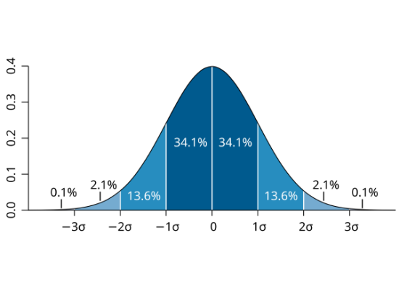


Normal Distribution & Variability
The Normal Distribution (Bell Curve) is defined by the Mean (central tendency) and Standard Deviation (spread).
Standard Deviation measures how dispersed the data is from the mean.

Slide 12
Research Hypotheses
Null Hypothesis (H0): The default position. Assumes no relationship or difference exists (e.g., "Design A is same as Design B").
Alternative Hypothesis (Ha): The statement we are testing for. Assumes a difference exists (e.g., "Design A is faster than Design B").
p-value: The probability of observing the results if the Null Hypothesis were true. A low p-value (< 0.05) rejects the Null.
Difference vs Correlation: Testing for group differences (t-test) vs. relationships between variables (Pearson correlation).

